Slide 1
Memento Patterns
Behavioral Patterns

Slide 2
Intent
The intent of this pattern is to capture the internal state of an object without violating encapsulation and thus providing a mean for restoring the object into initial state when needed.

Slide 3
Motivation
Objects frequently expose only some of their internal states using public methods.
You would still like to be able to save the entire state of an object because you might need to restore it later.
This sort of information saving and restoration is common in systems that need to support undo commands.

Slide 4
Problem
How to retrieve all required information of an object while preserving its encapsulation, e.g.
  public class Originator {
  int privateData; // no public method to get this attribute!
  private int otherData;
  int getOtherData() { return otherData; }
  }

Slide 5
Roles of Memento Pattern
The Memento Pattern attempts to solve this problem by having privileged access to the state of the object you want to save.
Other objects have only a more restricted access to the object, thus preserving their encapsulation. This pattern defines three roles of objects:
  The Originator is the object whose state we want to save.
  The Memento is another object that saves the state of the Originator.
  The Caretaker manages the timing of the saving of the state, saves the Memento and, if needed, uses Memento to restore the state of the Originator.

Slide 6
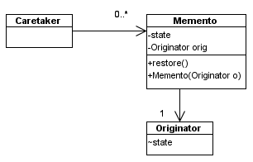
Structure

Slide 7
Java Implementation
Variables in Java can be declared as:
  Private - only the class can access
  Protected – the class and subclass can access
  Public – can be accessed by all other classes
  (package protected) – can be accessed by classes in the same package

Slide 8

Sample Codes
public class Originator {
int state = 0; // package protected attribute
public void action() {
state = state + 1;
}
public int getState() { return state; }
}

Slide 9
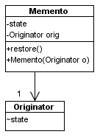
Sample Codes
public class Memento {
private int state;
Originator orig;
public Memento(Originator o) {
orig = o;
state = orig.state; // save originator’s state
}
public void restore() {
orig.state = this.state;
}
}

Slide 10
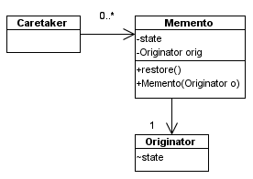
Sample Codes
public class Caretaker {
public static void main(String[] arg) {
Originator originator = new Originator();
Memento m0 = new Memento(originator); // keep the state in m0
originator.action(); // the action changes originator's state
originator.action();
System.out.println("state = " + originator.getState());
m0.restore(); // restore originator's state
System.out.println("state after restore = " + originator.getState());
}
}

Slide 11
A Simple Drawing Tool
Let’s consider a simple prototype of a graphics drawing program that creates rectangles, and allows you to select them and move them around by dragging them with the mouse.
This program has a toolbar containing four buttons:
  Create Shape
  Undo
  Redo
  And Clear

Slide 12
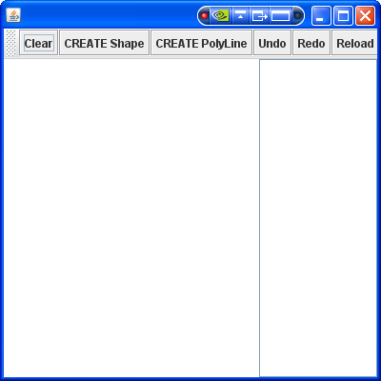
Sample Run
JToolBar & JButton
JPanel ( _panel )
List

Slide 13
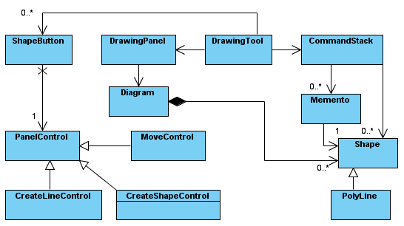
Design

Slide 14
Sample Code - Shape
import java.awt.Color;
import java.awt.Graphics;
class Shape {
private static int _idCounter = 0;
private int _x, _y, _width = 20, _height = 20, _id;
public Shape(int x, int y) {
this._x = x;
this._y = y;
this._id = ++_idCounter;
}

Slide 15
Sample Code - Shape
public void draw(Graphics g) {
g.setColor(Color.black);
g.drawRect(_x, _y, _width, _height);
g.drawString(String.valueOf(this._id), this._x, this._y
+ g.getFontMetrics().getHeight());
}
public boolean contains(int x, int y) {
return (x >= this._x && y >= this._y && x <= this._x + this._width && y <= this._y
+ this._height);
}

Slide 16
Sample Code - Shape
public void setLocation(int x, int y) {
this._x = x;
this._y = y;
}
public void setSize(int width, int height) {
this._width = width;
this._height = height;
}
public int getX() {
return this._x;
}
public int getY() {
return this._y;
}

Slide 17
Sample Code - Shape
public int getWidth() {
return this._width;
}
public int getHeight() {
return this._height;
}
public String toString() {
return "Create: Shape(" + this.getId() + ")";
}
public int getId() {
return this._id;
}
} // shape

Slide 18
Sample Code - Memento
class Memento {
private int _x, _y, _width, _height;
private Shape _shape;
public Memento() {
}
public Memento(Shape shape) {
this._shape = shape;
this._x = shape.getX();
this._y = shape.getY();
this._width = shape.getWidth();
this._height = shape.getHeight();
}

Slide 19
Sample Code - Memento
public void restore() {
this._shape.setLocation(this._x, this._y);
this._shape.setSize(this._width, this._height);
}
public Shape getShape() {
return this._shape;
}
public String toString() {
return "Move: Shape(" + this.getShape().getId() + ")";
}
} // Memento

